Slide 1

Wiki Associative Expert System
“for masses”
Jacek Głodek
FEIT, WUT
EINIS – mini-lecture
23 May 2012r.

Slide 2
agenda
The problem
The solution
The data
The knowledge
The process
Jacek Głodek

Slide 3
The problem
Jacek Głodek

Slide 4

The problem
Jacek Głodek

Slide 5
The problem
IT security education
Jacek Głodek

Slide 6
The problem
IT security education
changing
data
Jacek Głodek

Slide 7
The problem
IT security education
changing
data
education
Jacek Głodek

Slide 8
The problem
IT security education
changing
data
education
relations
search
Jacek Głodek

Slide 9
The problem
IT security education
lots of
data
changing
data
education
relations
search
Jacek Głodek

Slide 10
The problem
IT security education
lots of
data
UX
changing
data
education
relations
search
Jacek Głodek

Slide 11

The solution
IT security education
lots of
data
UX
changing
data
education
relations
search
Jacek Głodek

Slide 12
The solution
IT security education
lots of
data
✔
UX
changing
data
education
relations
search
Jacek Głodek

Slide 13
The solution
IT security education
lots of
data
✔
UX
✔
changing
data
education
relations
search
Jacek Głodek

Slide 14
The solution
IT security education
lots of
data
✔
UX
✔
changing
data
education
x
relations
search
Jacek Głodek

Slide 15
The solution
IT security education
lots of
data
✔
UX
x
✔
changing
data
education
x
relations
search
Jacek Głodek

Slide 16
The solution
IT security education
x
lots of
data
✔
UX
x
✔
changing
data
education
x
relations
search
Jacek Głodek

Slide 17
Finding the smarter solution
Jacek Głodek

Slide 18

Finding the smarter solution
Apps
Jacek Głodek

Slide 19

Finding the smarter solution
Problems and risks,
security issues
Apps
Jacek Głodek

Slide 20
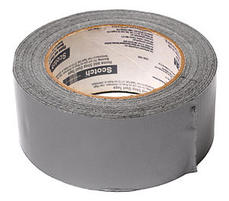

Finding the smarter solution
Problems and risks,
security issues
Solutions,
fixes
Apps
Jacek Głodek

Slide 21
The smarter solution
Wiki associative expert system
Jacek Głodek

Slide 22
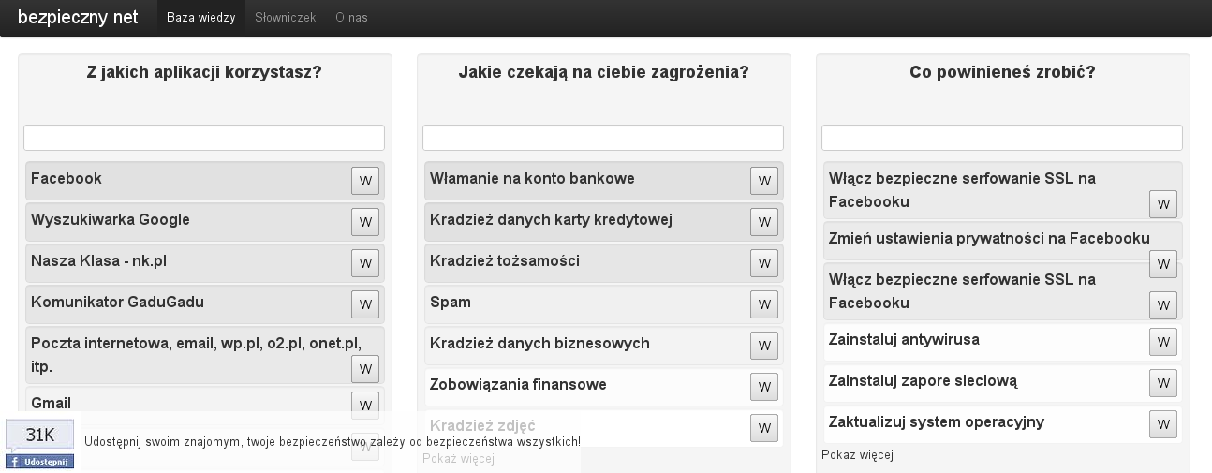
The smarter solution
Wiki associative expert system
Jacek Głodek

Slide 23
The smarter solution
Wiki associative expert system
APPS
Jacek Głodek

Slide 24
The smarter solution
Wiki associative expert system
APPS
RISKS
Jacek Głodek

Slide 25
The smarter solution
Wiki associative expert system
APPS
RISKS
FIXES
Jacek Głodek

Slide 26
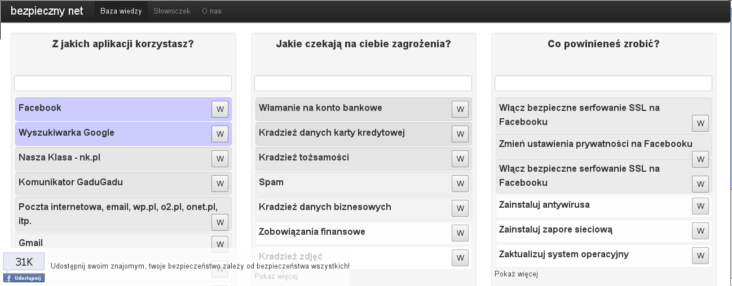
The smarter solution
Wiki associative expert system
APPS
RISKS
FIXES
Jacek Głodek

Slide 27
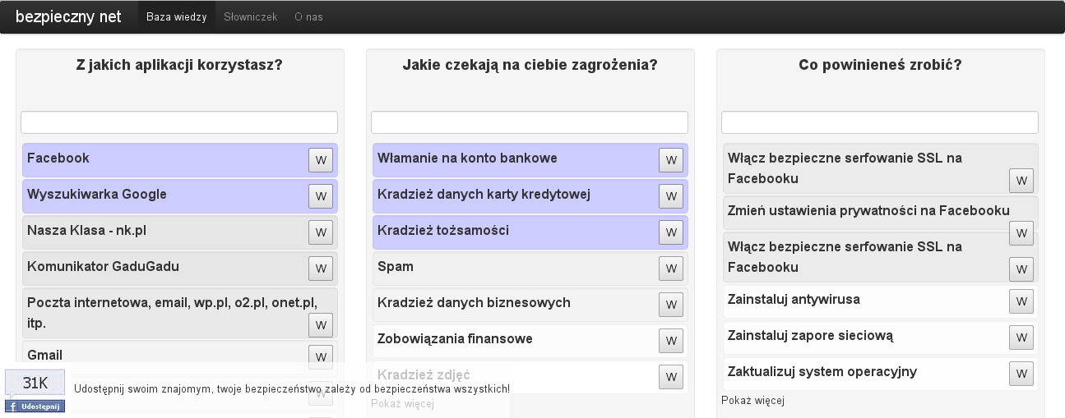
The smarter solution
Wiki associative expert system
APPS
RISKS
FIXES
Jacek Głodek

Slide 28
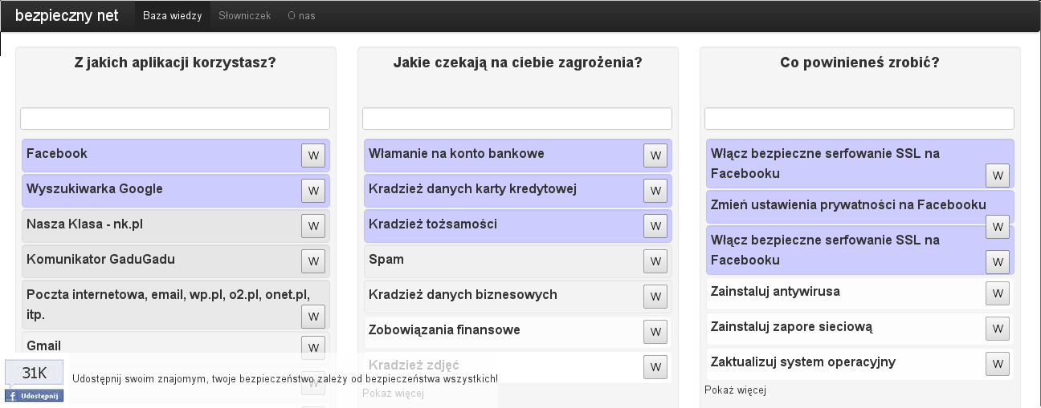
The smarter solution
Wiki associative expert system
APPS
RISKS
FIXES
Jacek Głodek

Slide 29
It's pretty generic:
Jacek Głodek

Slide 30
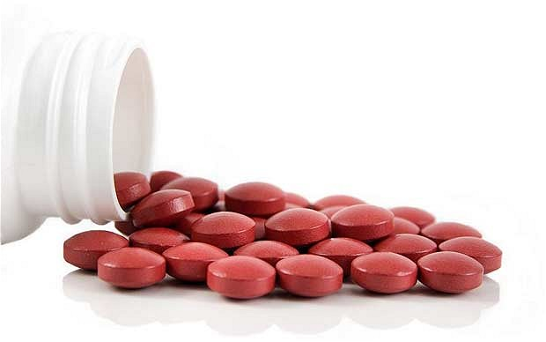
It's pretty generic:
Symptoms
Diseases
Treatments
Jacek Głodek

Slide 31
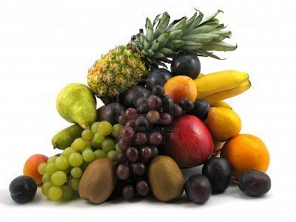
It's pretty generic:
Symptoms
Diseases
Treatments
What I have in my refrigerator,
Products
Recipes
Properties
Milk-free, low-fat,
vegan, vegetarian, Kosher,
Halal, etc.
Jacek Głodek

Slide 32
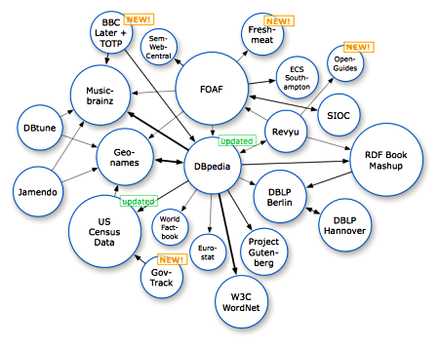
But where's intelligence?
Jacek Głodek

Slide 33
But where's intelligence?
Semantic relations
Jacek Głodek

Slide 34
But where's intelligence?
Semantic relations
Supported search
Jacek Głodek

Slide 35
But where's intelligence?
Semantic relations
Supported search
Recommendation mechanism
Jacek Głodek

Slide 36
So what's the data?
Jacek Głodek

Slide 37
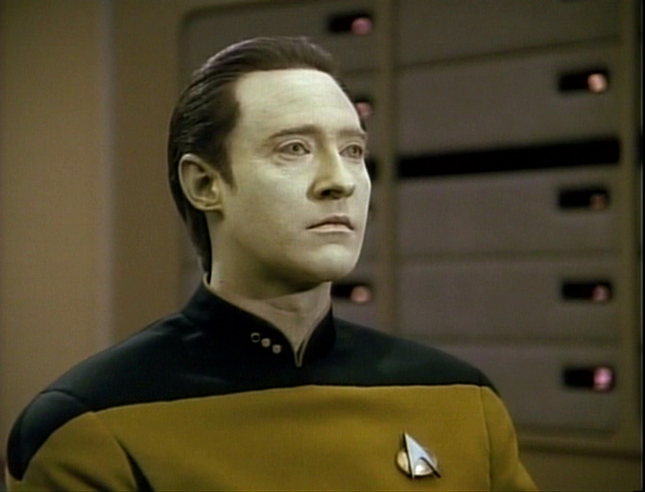
So what's the data?
Jacek Głodek

Slide 38
So what's the data?
Wiki pages
Jacek Głodek

Slide 39
So what's the data?
Wiki pages
User queries
history
Jacek Głodek

Slide 40
So what's the data?
Wiki pages
User queries
history
User navigation
history
Jacek Głodek

Slide 41
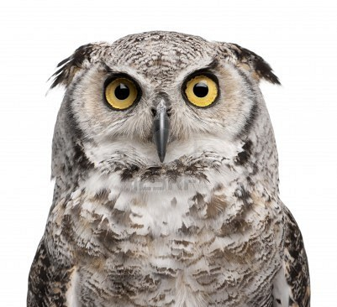
So where's the knowledge?
Jacek Głodek

Slide 42
So where's the knowledge?
Expert knowledge
Jacek Głodek

Slide 43
So where's the knowledge?
Popular queries
Expert knowledge
Jacek Głodek

Slide 44
So where's the knowledge?
Popular queries
Expert knowledge
Similarity of wiki page contents
Jacek Głodek

Slide 45
Process 1
1:1 mapping
Expert knowledge
page2page relation
n-gram comparision
Wiki pages
page2page relation
frequent patterns
User interaction
page2page relation
Jacek Głodek

Slide 46
Process 2
page2page relation
k
+
page2page relations
cache
page2page relation
k
k
page2page relation
Jacek Głodek

Slide 47
Process 3
page2page relations
cache
+
Query
Result list
Wiki pages
Jacek Głodek

Slide 48
This is what I do for
my master thesis
Jacek Głodek

Slide 49
And...
Jacek Głodek

Slide 50

And...
U HAZ QUESTIONZ?
*obligatory kitten photo
Jacek Głodek

Slide 51
Thank You!
Jacek Głodek
jacek.glodek@gmail.com
project: soon on github: jglodek/wiki-expert
Jacek Głodek

Slide 52
Images in this presentation were used
for educational purpose and do not effect the use upon the potential market for the copyrighted work.
Jacek Głodek

